Slide 1
Software Construction Laboratory CS35L – Lab 1
Course Webpage: https://web.cs.ucla.edu/classes/fall18/cs35L/index.html
TA: Zhiyi Zhang
Email: zhiyi@cs.ucla.edu
Webpage: https://zhiyi-zhang.com

Slide 2
Session 5-1
User mode and Kernel mode
System Calls
System Call Programming

Slide 3
User Mode and Kernel Mode

Slide 4
Processor/Operating/CPU Modes
Operating systems place restrictions on the type and scope of operations that can be performed by certain processes
only highly trusted kernel code is allowed to execute in the unrestricted mode
Notes:
integer factorization, discrete logarithm

Slide 5
User Mode v.s. Kernel Mode
User Mode (mode bit = 1)
restricted access to system resources
CPU restricted to unprivileged instructions and a specified area of memory
Kernel Mode (mode bit = 0)
unrestricted access
CPU is unrestricted, can use all instructions, access all areas of memory and take over the CPU anytime

Slide 6
Why Dual-mode Operation?
System resources are shared among processes and the OS must ensure
Protection: an incorrect/malicious program cannot cause damage to other processes or the system as a whole
Prevent processes from accessing illegal memory and modifying kernel code and data structures
Prevent processes from performing illegal I/O operations
Fairness: Make sure processes have a fair use of devices and the CPU
Prevent a process from using the CPU for too long

Slide 7
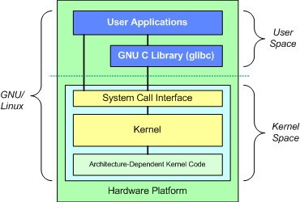
Only Kernel Code is Trusted
Core of OS software executing in kernel/supervisor state
Trusted software:
Software who manages hardware resources (CPU, Memory and I/O)
Software who implements protection mechanisms that could not be changed through actions of untrusted software in user space
System call interface is a safe way to expose privileged functionality and services of the processor

Slide 8
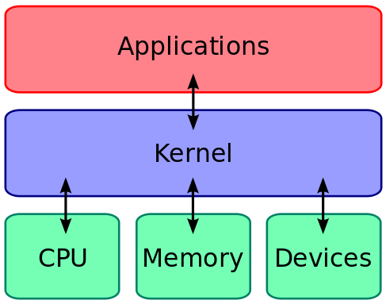
How User Mode Processes Use Kernel Space?
The kernel executes privileged operations on behalf of untrusted user processes
The way is using system calls

Slide 9
System Calls

Slide 10
System Calls
Special type of function that:
Used by user-level processes to request a service from the kernel
Changes the CPU’s mode from user mode to kernel mode to enable more capabilities
Is part of the kernel of the OS
Verifies that the user should be allowed to do the requested action and then does the action (kernel performs the operation on behalf of the user)
Is the only way a user program can perform privileged operations

Slide 11
When System Calls Are Made
When a system call is made, the program being executed is interrupted and control is passed to the kernel
If operation is valid, the kernel performs it

Slide 12
System Call Overhead
System calls are expensive and can hurt performance
The system must do many things
Process is interrupted & computer saves its state
OS takes control of CPU & verifies validity of op.
OS performs requested action
OS restores saved context, switches to user mode
OS gives control of the CPU back to user process

Slide 13
Systems Calls
Services Provided by System Calls
Process creation and management
Main memory management
File Access, Directory and File system management
Device handling(I/O)
Protection
Networking, etc.
Types of System Calls
Process control: create, abort, and terminate process; allocate and free memory.
File management: create, open, close, delete, read file etc.
Device management
Information maintenance
Communication

Slide 14
Examples
Process Control | fork(), exit(), wait()
File Manipulation | open(), read(), write(), close()
Device Manipulation | ioctl(), read(), write()
Information Maintenance | getpid(), alarm(), sleep()
Communication | pipe(), shmget(), mmap()
Protection | chmod(), umask(), chown()

Slide 15
System Call Programming

Slide 16
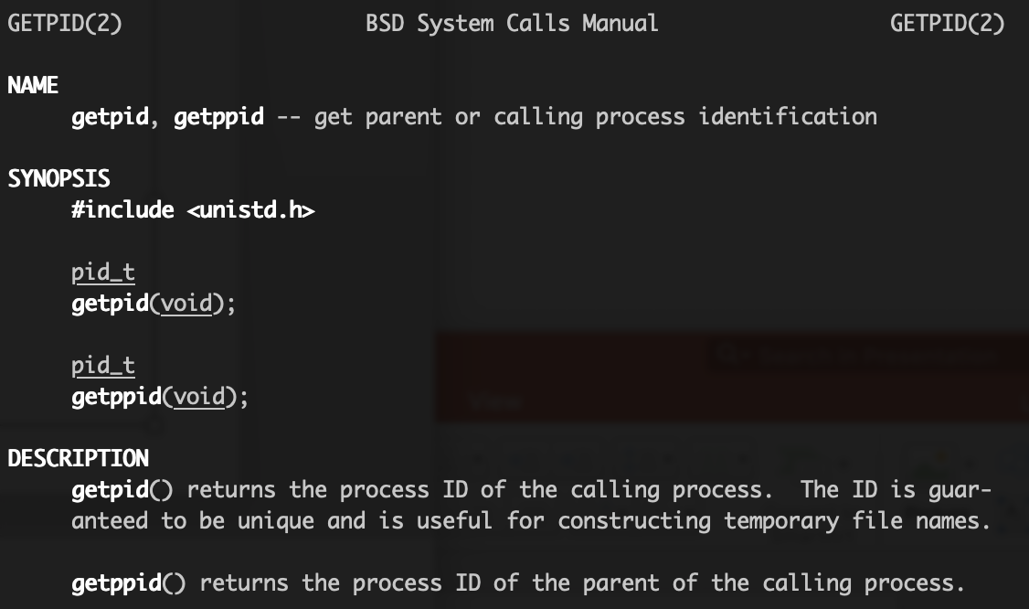
How to Use System Calls?
Use man to check the system calls
Examples:
getpid(), getppid()
read(), write(),
open(), close()
fstat(),
dup()

Slide 17
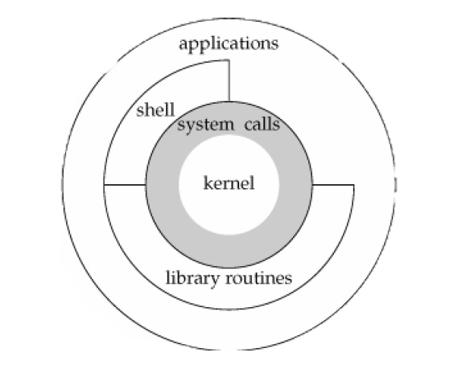
System Call Through Library Functions
Functions that are a part of standard C library
To reduce system call overhead, use equivalent library functions
getchar, putchar vs. read, write (for standard I/O)
fopen, fclose vs. open, close (for file I/O), etc.
How do these functions perform privileged operations?
They make system calls
So what’s the difference?

Slide 18
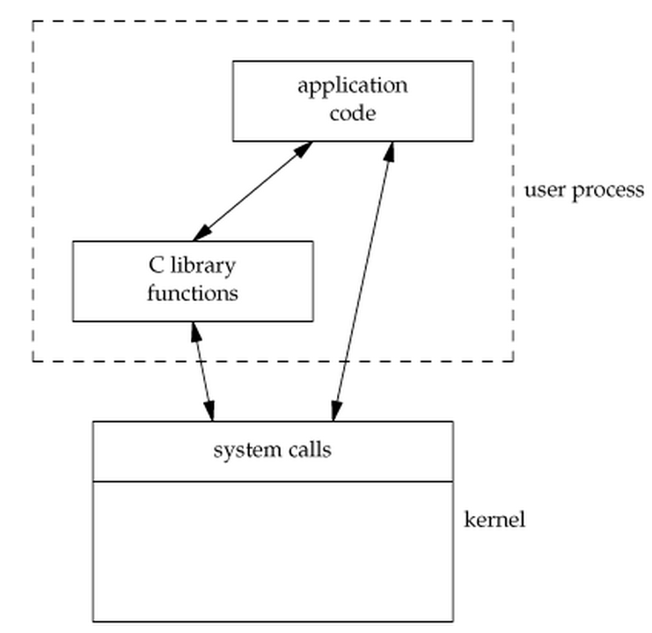
Why Bother?
Libraries wrap the system call and optimize the performance
Usually less system calls
Non-frequent switches from user mode to kernel mode
Therefore less overhead and better developing experiences.

Slide 19
Library Function Call Examples
getchar, putchar vs. read, write (for standard I/O)
fopen, fclose vs. open, close (for file I/O)
malloc vs. brk sbrk (for memory allocation)
…

Slide 20
Case Study: Why fopen Is Better Than open
fopen provides you with buffered I/O while open is unbuffered I/O
Every byte is read/written by the kernel through a system call in unbuffered I/O while buffered I/O collect as many bytes as possible (in a buffer) and read more than a single byte (into buffer) at a time and use one system call for a block of bytes
fopen returns FILE struct which can also be used by other stdio functions like fscanf()
fopen can work across platforms (fopen can work on platforms that does not use open, e.g., some old versions of C)
Notes:
Buffered I/O decreases the number of read/write system calls and the corresponding overhead

